Slide 1

Introduction to HTML and CSS
By Ms. Piyali Mondal
Session 1

Slide 2
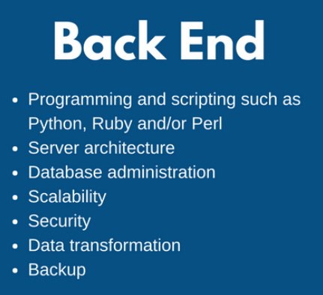
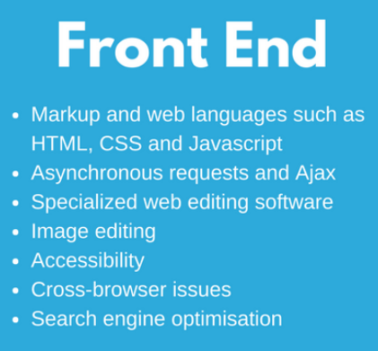


Website

Slide 3
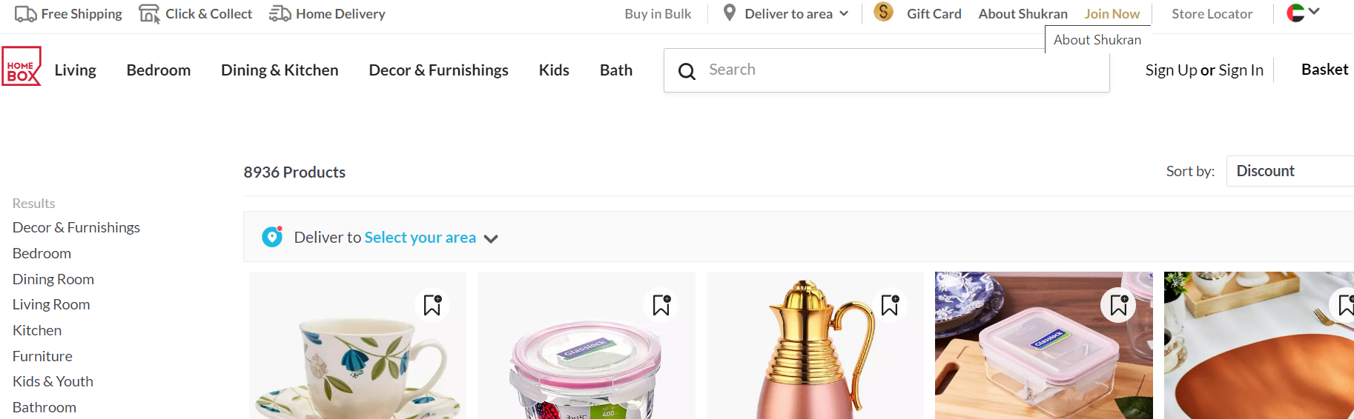
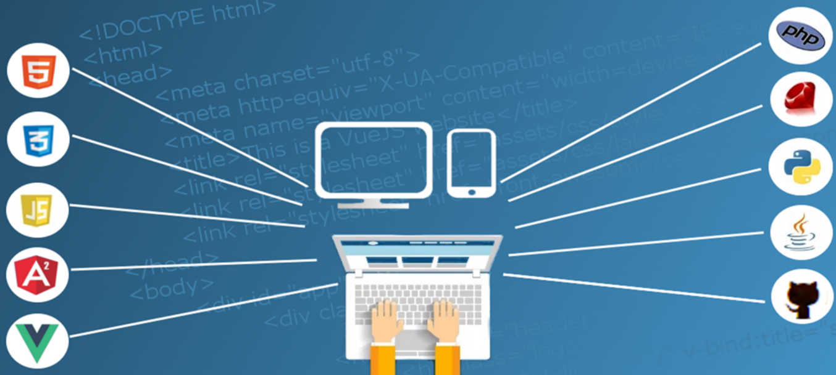
Website
Front End
Back end

Slide 4
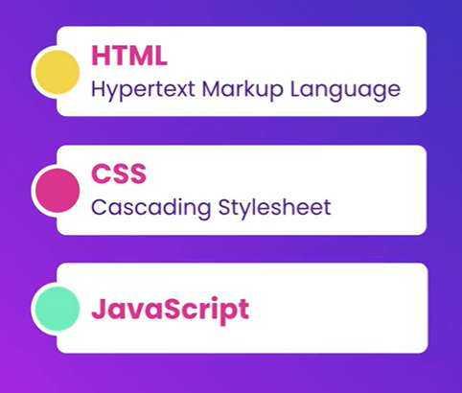
Front end web-development

Slide 5
Front end web-development

Slide 6


Front end web-development
Building websites often includes bunch of repetitive class
We use front end framework and libraries
Framework or library comes with lot of codes that we can reuse in our websites.
These are the library/framework which helps us build
our applications faster
React is a powerful library and is very popular for
beginners
Version Control system like GIT is used the to keep track of projects while working collaboratively.

Slide 7
HTML
HTML (Hypertext Markup Language) is used to create document on the World Wide Web. It is simply a collection of certain key words called ‘Tags’ that are helpful in writing the document to be displayed using a browser on Internet.
It is a platform independent language that can be used on any platform such as Windows, Linux, Macintosh, and so on. To display a document in web it is essential to mark-up the different elements ( headings, paragraphs, tables etc. ) of the document with the HTML tags. To view a mark-up document user has to open the document in a browser. A browser understands and interpret the HTML tags, identifies the structure of the document (which part are which) and makes decision about presentation (how the parts look) of the document.
HTML also provides tags to make the document look attractive using graphics, font size and colours. User can make a link to the other document or the different section of the same document by creating Hypertext Links also known as Hyperlinks

Slide 8
Introduction to HTML
HTML is used for describing web pages.
HTML stands for Hyper Text Markup Language
HTML is not a programming language, it is a markup language
A markup language is a set of markup tags
HTML uses markup tags to describe web pages

Slide 9
Introduction to HTML
Web Browser options
Google Chrome
Mozilla Firefox
Internet Explorer
Safari
Edge
……
Text Editor options
Visual Code Studio
Sublime Text
Atom.io
Brackets
Notepad ++
…….
CHOOSE AND DOWNLOAD YOUR TEXT EDITOR

Slide 10
Create your First HTML File
Creating a html file does not need a server
Files will have a .html extension
The file will run any Web Browser (Google Chrome, Mozilla Firefox, Internet Explorer, Safari, Edge etc.)
index.html is the root of any website

Slide 11

Common Terminology
Some commonly used terms in HTML are:
a)Tag: Tags are always written within angles brackets. It is a piece of text is used to identify an element so that the browser realizes how to display its contents. e.g.<HTML> tag indicates the start of an HTML document .
HTML tag are of two types
Paired Tags :A tag is said to be a paired tag if text is placed between a tag and its companion tag. In paired tag ,the first tag is referred to as opening tag and the second tag is referred to as closing tag.
Unpaired Tags: An unpaired tag does not have a companion tag .unpaired tag also known as singular or Stand-Alone tags. e.g:<br>,<hr> etc.

Slide 12
Common Terminology
b) Attribute: Attribute is the property of an tag that specified in the opening angle brackets. It supplies additional information like color, size, home font-style etc to the browser about a tag. E.g. most of the common attributes are height, color, width, src, border, align etc.
c) DTD: Document Type Definition is a collection of rules written in standard Generalized Markup Language(SGML). HTML is defined in terms of its DTDS. All the details of HTML tags, entities and related document structure are defined in the DTDS.
d) ELEMENT: Element is the component of a document’s structure such as a title, a paragraph or a list. It can include an opening and a closing tag and the contents within it.

Slide 13
HTML Tag Syntax
HTML tag is the basic building block of any webpage
Elements should be surrounded by angle brackets
<tagname>
Normally there is a start tag and end tag. End tag is usually the same but with a forward slash
<tagname>content</tagname> e.g. <h1>About us</h1>
Some tags close themselves. They do not have any content within them, specifically used for line breaking.
<br/>

Slide 14
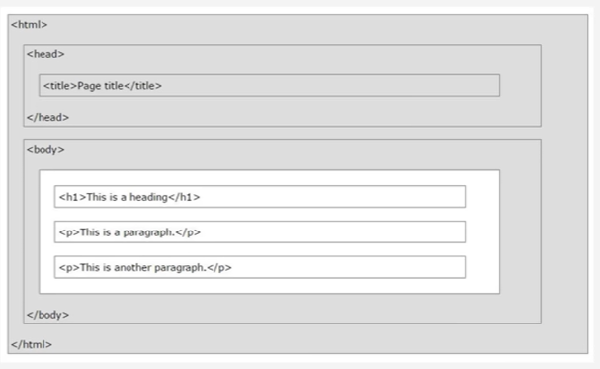
HTML page structure
We have a start and end tag
We have head area
We have body area
Head area contains information/description about the webpage
Things in the body area will be displayed in the browser

Slide 15
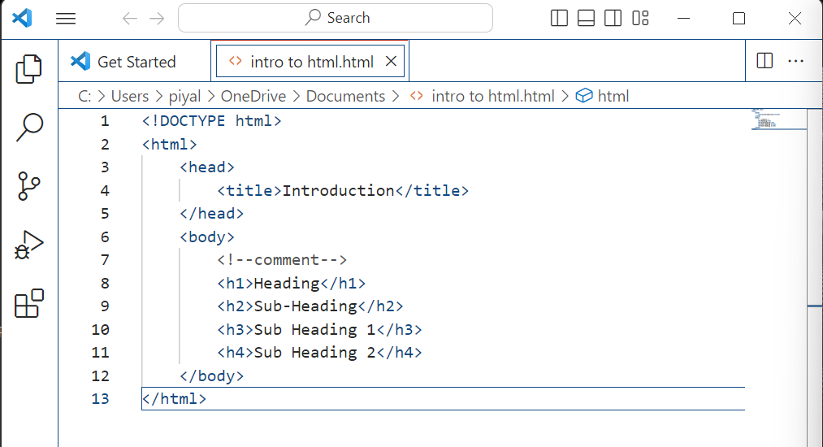

Slide 16
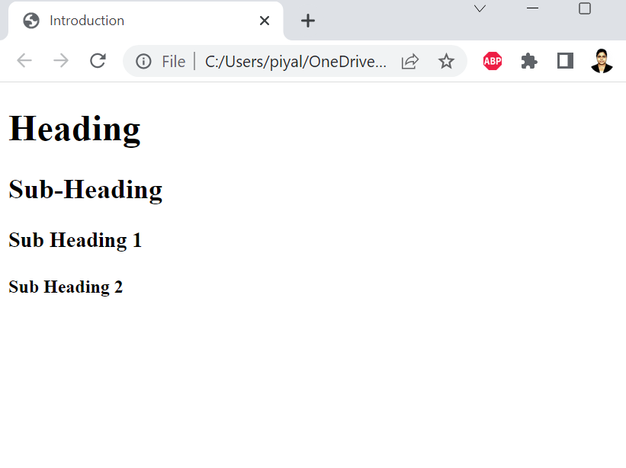

Slide 17
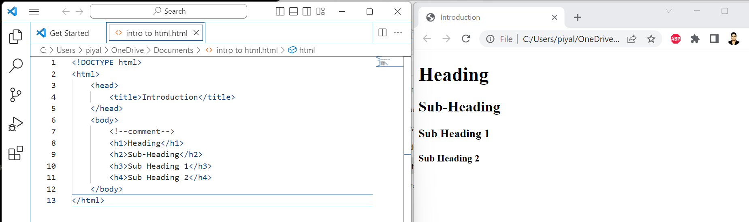

Slide 18
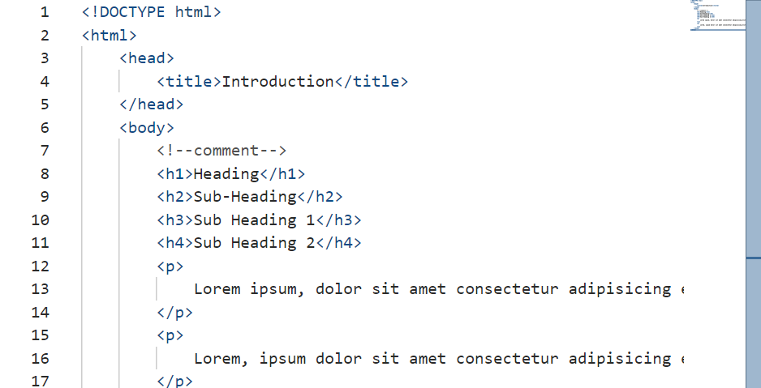

Slide 19
Inline elements
<strong>text</strong>
<em>text</em>
<a href=“ ”>text</a>
<a href="http://google.com">
<a href="http://google.com" target="_blank">text</a>

Slide 20
Tag Attributes
All tags have attributes
Attribute provides information about element
Attributes are placed within start tags
Key/value pairs (id=‘someid’)
<a href="http://google.com" target="_blank">text</a>

